Slide 1
Vision 3D Final Project
3D photography on your desk
Based on paper
paper.dvi (umontreal.ca)
By
Ohad Klein 318421476
Aviel Raclaw 318965647

Slide 2
The paper in a nutshell
The paper aims to reconstruct a 3D scene from a degenerate 2D setup, taken from a single non-moving camera.
Using shadows cast on the scene and projective geometry, one is able to find the 3D location of each pixel in the image, with respect to some predefined coordinate system.
At each frame a pencil casts on the scene a straight shadow line, which bends in correspondence to object height.
This method provides us with temporal information regarding each pixel, and with this information we are able to construct the 3D scene.

Slide 3
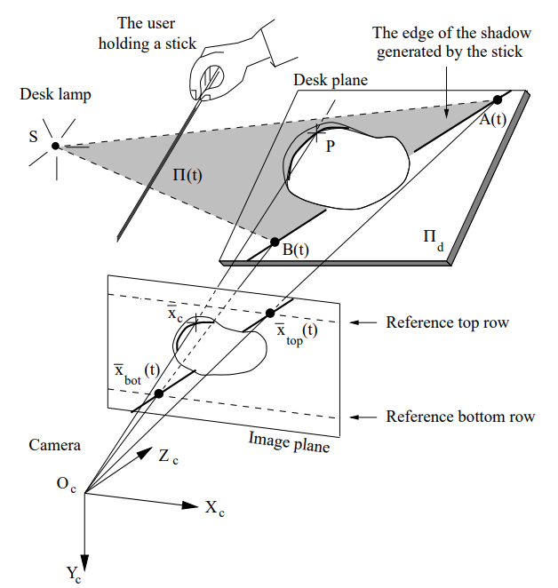
The paper in a nutshell
The 3D location of each pixel on the shadow line is computed as the intersection between:
a line determined by the camera center and the pixel’s projection on the floor plane.
A plane determined by two points on both edges of the shadow line, and the light source location.

Slide 4
Our steps for generating a 3D scene

Slide 5
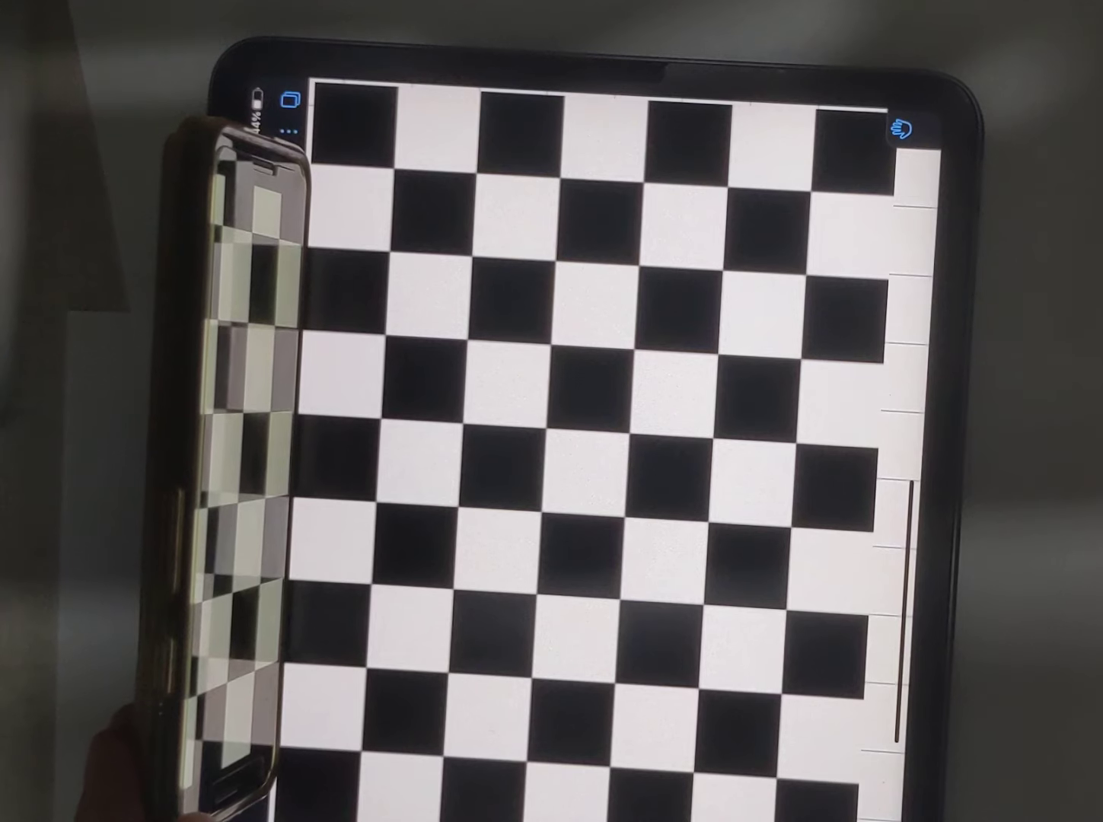
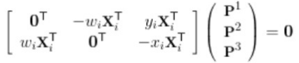
Initial setup - defining the coordinate system & locating camera center
After setting up a clean white background for the scan (to avoid noise), set up the camera.
Finding camera calibration:
Using 2 checkerboards placed perpendicular to one another, choose a point as the origin.
Choose 6 independent points on the checkerboards, and match the 3D coordinate points to their corresponding 2D pixel coordinates in the image.
Using SVD, perform extrinsic camera calibration and get the camera matrix.
Take the camera center coordinates as the null space of the camera matrix.

Slide 6
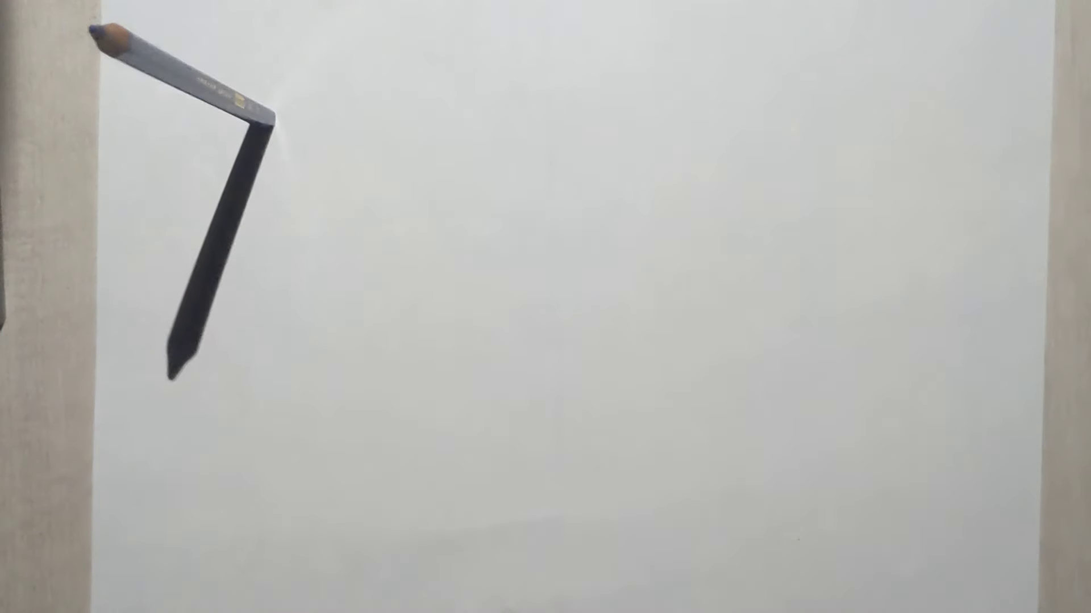
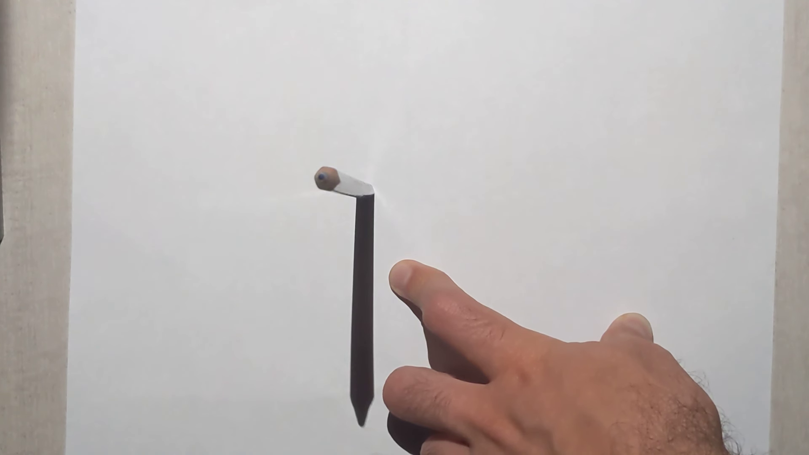
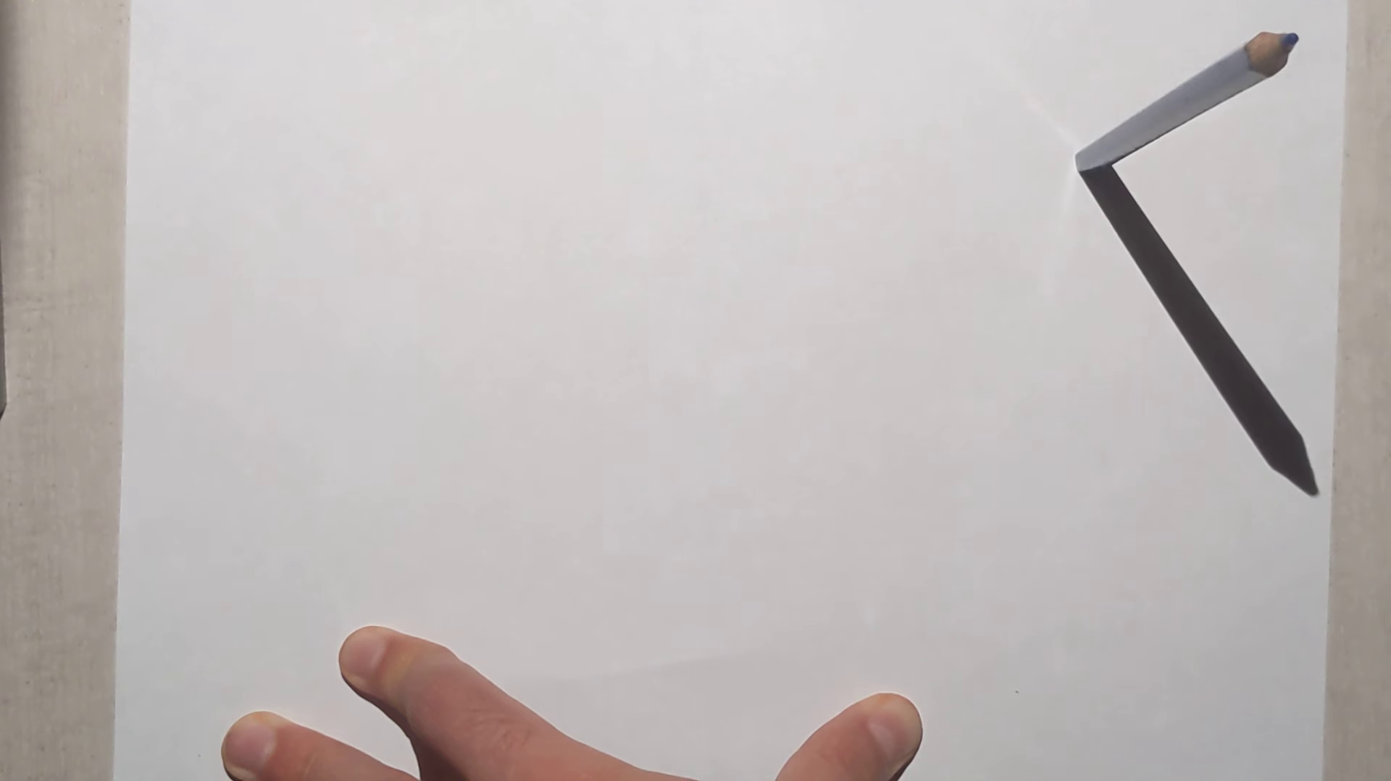
Initial setup - light source
Set up light source. Using a pencil of known length in the coordinate system units, we can find the light source location in the 3D coordinate system:
Get at least 2 photos of the pencil standing up in different locations.
(In practice we took 3 photos.)

Slide 7
Initial setup - light source
Using the camera matrix, get the 3D locations of the pencil tip shadow and the pencil base (assuming Z=0). The pencil tip is obtained by known height.
Assuming lines on floor are 2D (so they must intersect unless parallel), we'll find their 2D intersection which is the x,y coordinates of the light source.
(In practice, we find the intersection of each pair of 2 lines, and later we take the mean of all intersections.)

Slide 8
Initial setup - light source
To find the Z coordinate of the light source, we compute for some pair (pencil tip shadow, pencil tip) the direction vector d which defines the line between tips shadow_tip + t*d. Noting that the light source is also on this line, we find the t for which light_source = shadow_tip + t*d and use it to find Z.
(In practice, we already computed 3 possibilities for the X,Y of the light source, so we can compute t = (X - shadow_tip_x) / d. Then we get Z = shadow_tip_z + t*d.)
Now we have 3 possibilities for the 3D location of the light source - we take the final point (X, Y, Z) as their mean.

Slide 9
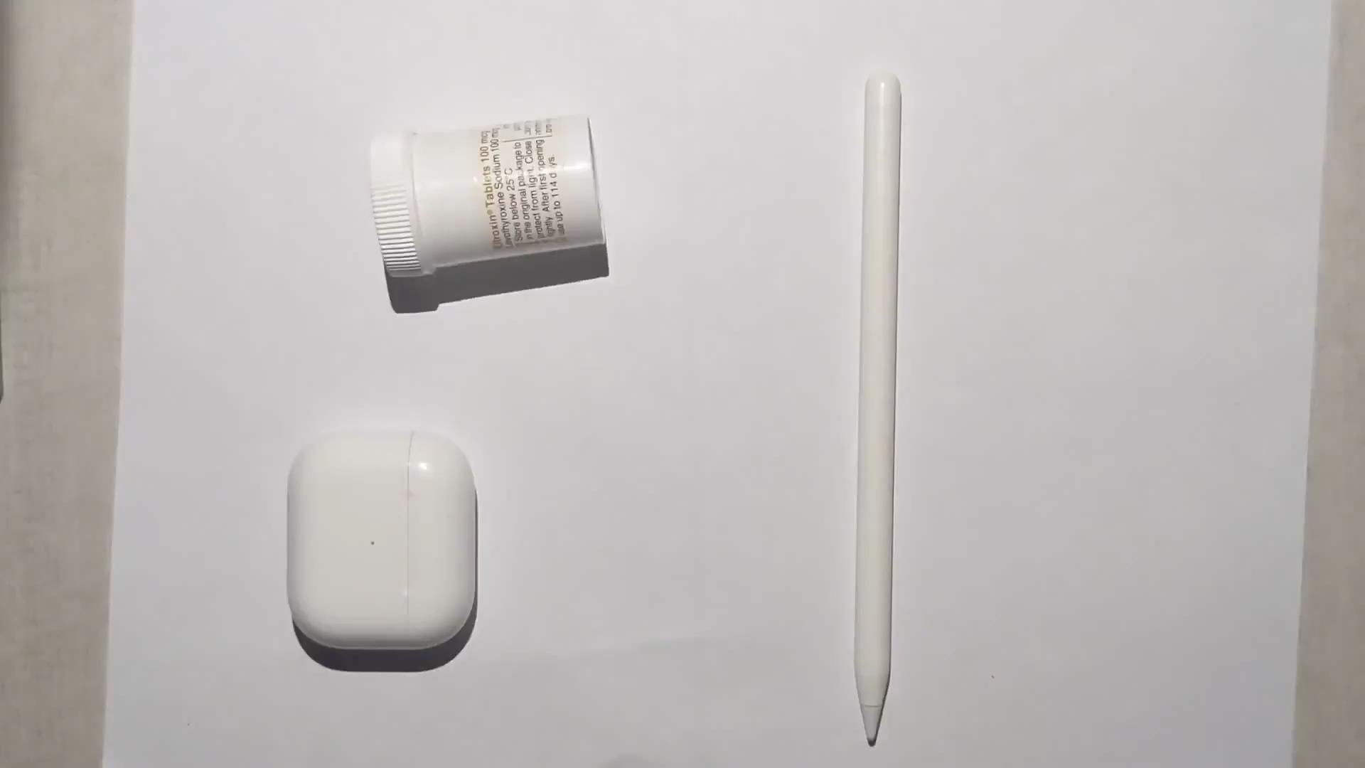
Scene capture
Place object for scanning in front of camera.
While filming, slowly move pencil-like object across light source, creating a shadow that moves over the object being scanned.

Slide 10
Scene capture
We’d now like to get the “shadow time” of each pixel - the first frame in which the pixel is under a shadow.
We will later use the shadow times to infer the 3D location of each pixel.
Initiate a table ts with shape == image.shape and values -1.
Iterate over the frames in the (grayscale) video; at each frame t, for each pixel (x,y) in the image, set ts[x,y] = t if and only if t is the first frame at which: |video[t,x,y] - video[0,x,y]| > threshold (we set the threshold to 70 like the paper suggests).

Slide 11
Scene capture
Now we wish to find, at each frame t, the equation of the shadow line at that frame. The equation can be defined by two points on that line. Like the paper suggests, we take points from both edges of the line - left and right.
Create two arrays lefts, rights of the size of the number of frames in the scanned scene, and fill them with values -1
Iterate over the frames, at each frame iterate over the columns of the image: first from left to right in order to find the left point, then in reverse to find the right point.
Set lefts[t] (rights[t]) = (x,y) if and only if ts[x,y] = t (x,y enters the shadow at frame t), and all its neighbors x’,y’ hold |ts[x,y] - ts[x’,y’]| <= 1 (to filter out noisy pixels).

Slide 12
Scene capture
Now that we have the lefts and rights pixel points of each frame’s shadow line, we are ready to find the 3D location of each pixel in the image.
For pixel (x,y) we infer the 3D location by following these steps:
Get t = ts[x,y], the index of the frame where (x,y) enters the shadow.
Finding the shadow plane:
Get a, b = lefts[t], rights[t], the 2 pixel points on the shadow line edges. Since these points lie on the floor plane, we know that their 3D corresponding points hold Z==0. Using this and the camera matrix, we can solve with SVD to find the point A (B) = (X,Y,0) such that (X,Y,0)*camera_matrix=a (b).
Using A, B and the light_source we found earlier, we now know the shadow plane equation.

Slide 13
Scene capture
Finding the line between the camera center and (x,y):
We want to find another point on that line, since we do not know the 3D representation of (x,y).
Using the same method as with a,b, we assume that (x,y) lies on the floor plane and find the corresponding (X’,Y’,0) point on the plane.
The actual 3D representation of (x,y) lies on the line between the camera center and the point (X’,Y’,0).
Now that we know both the line and the plane which our point lies on, we can find it by intersecting them.

Slide 14
Scene capture
To find the intersection between the line and the plane we note that:
If the plane is defined by a normal N = (a,b,c) and a point pp,
and the line is defined by a point pl and vector d s.t. pl + t*d defines any point on the line,
So, a point p0 = pl + t0*d lies on the plane iff p0 - pp is orthogonal to N
iff dot(N, p0 - pp) = 0
iff dot(N, pl + t0*d - pp) = 0
iff dot(N, pl - pp) + t0 * dot(N, d) = 0
iff t0 = -dot(N, pl - pp) / dot(N, d)
We take N=(A-light_source)X(B-light_source) and pp=light_source, and pl=camera_center and d=(X’,Y’,0)-camera_center.

Slide 15
Scene capture
Finally, after finding t0, we can substitute it for t in the line equation to get the 3D coordinates of the pixel (x, y):
(X,Y,Z) = camera_center + t0 * ((X’,Y’,0) - camera_center)
Following these steps for each pixel (x,y), we infer the entire 3D scene from the 2D video.

Slide 16
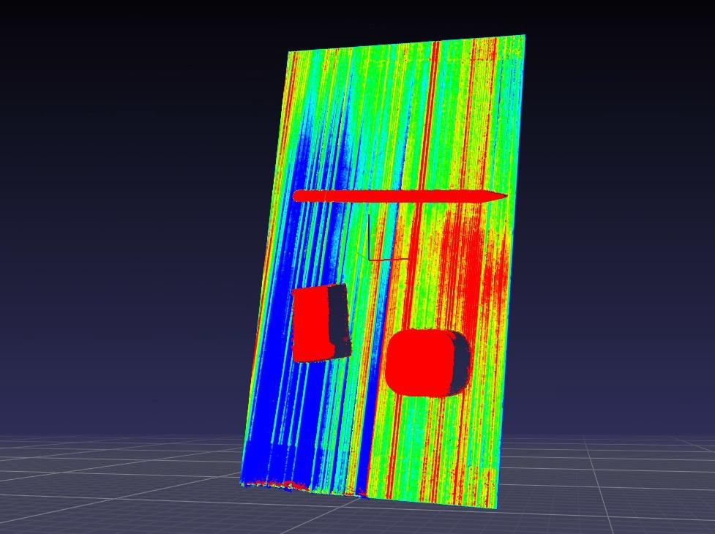
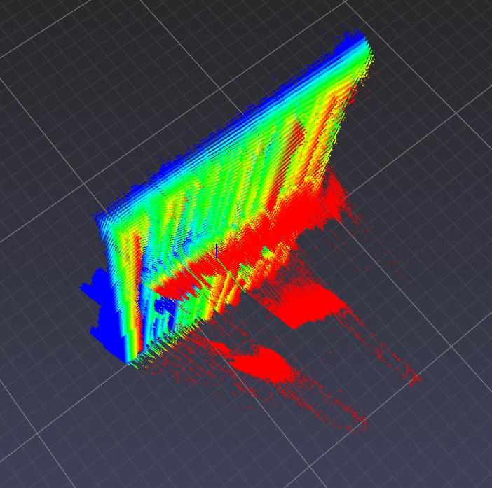
Results

Slide 17
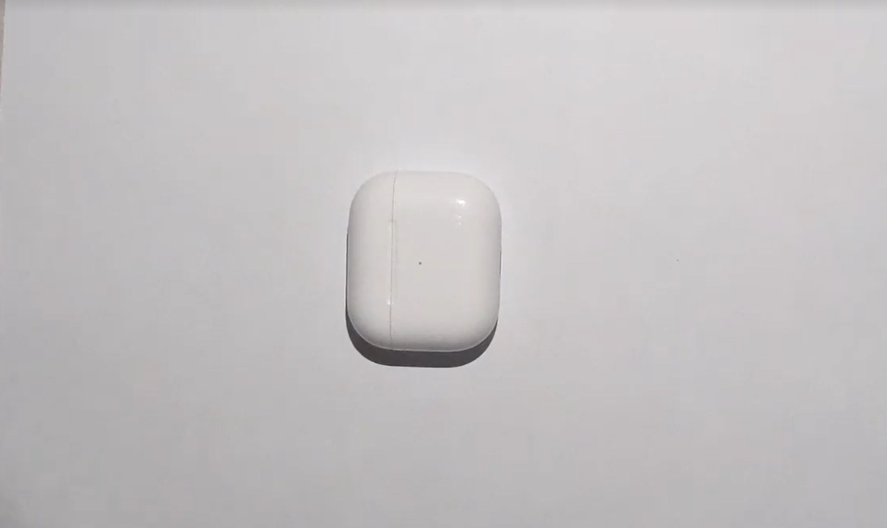
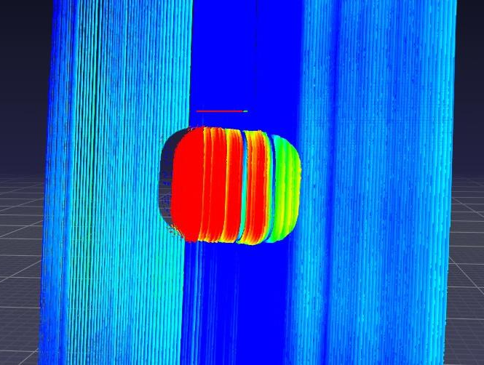
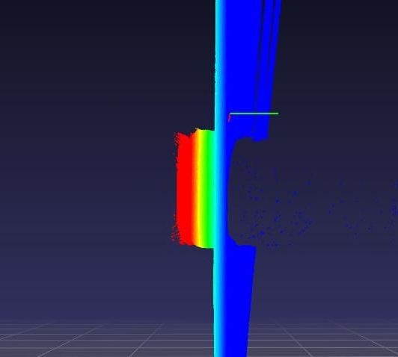
More Results
input
output

Slide 18
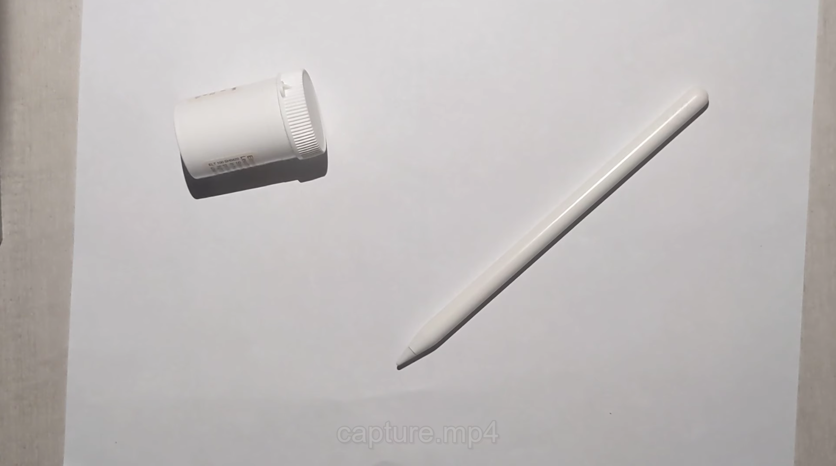
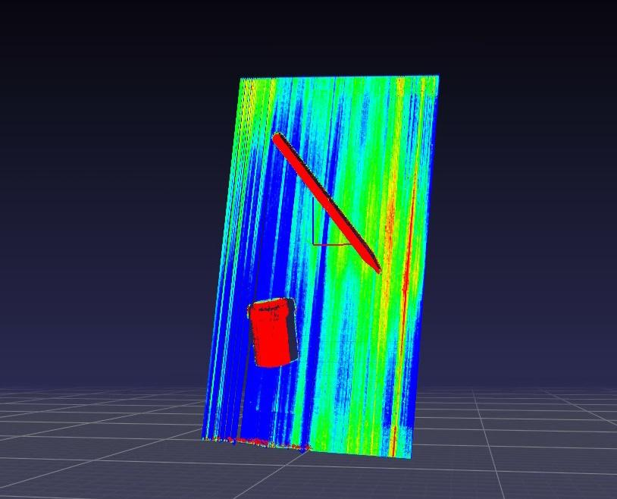
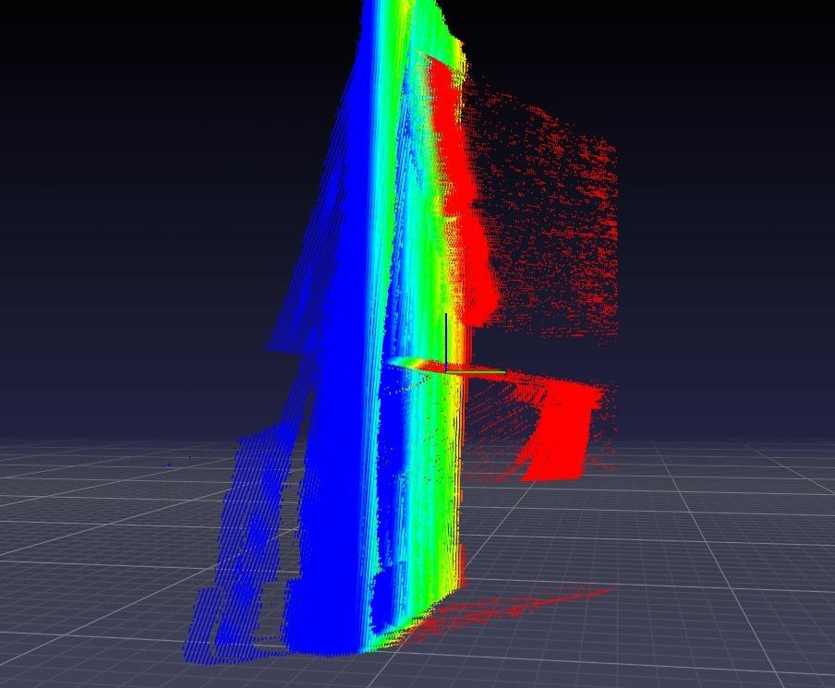
More Results
input
output

Slide 19
Note the height difference between the pill box and its lid - This emphasizes the process’ sensitivity.

Slide 20
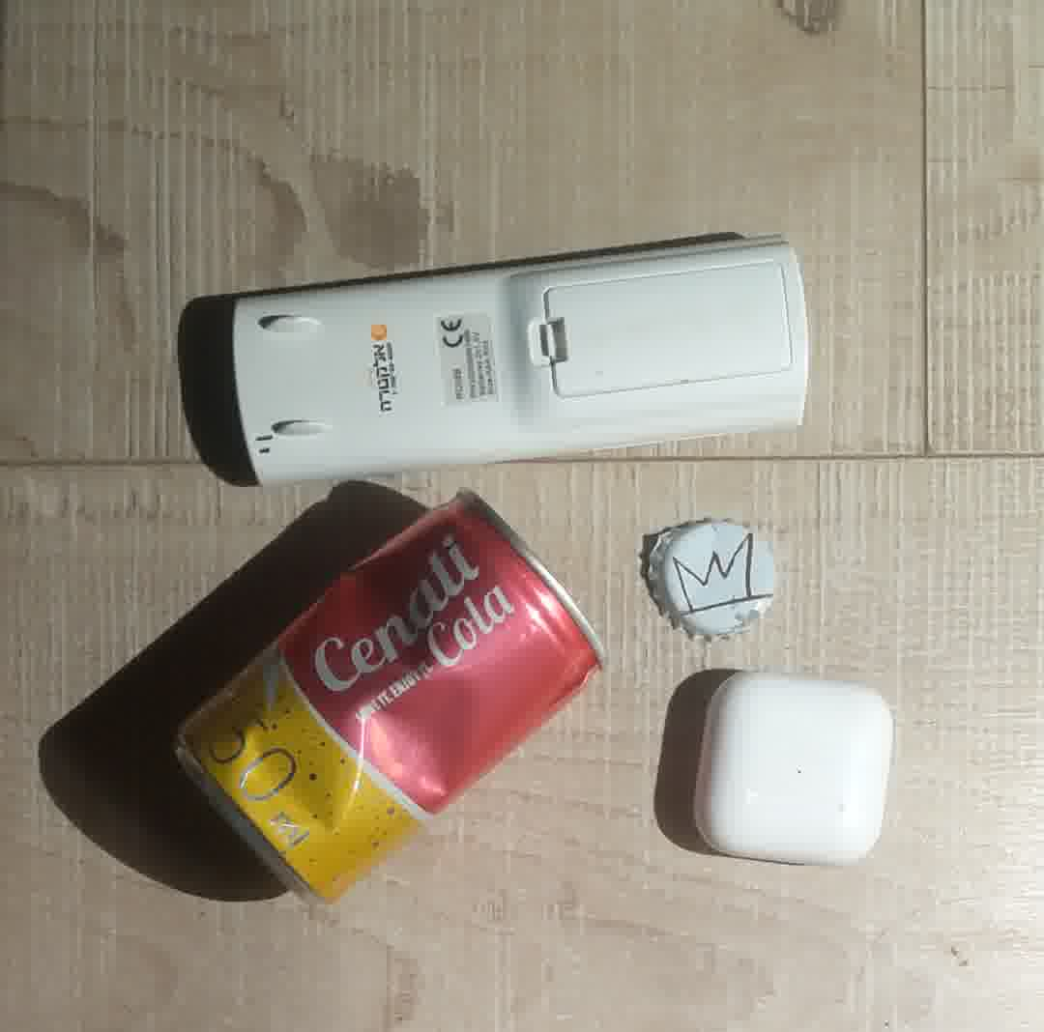
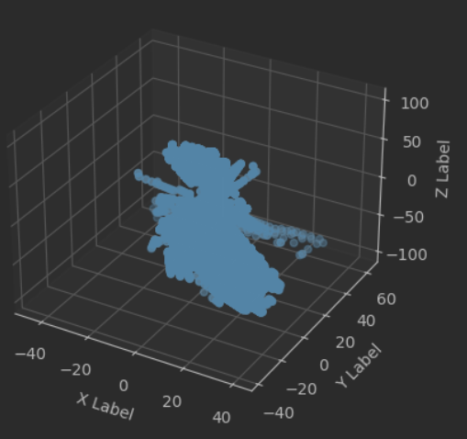
Limitations
From trial and error, we discovered that this algorithm fails to generate a good 3D scene when one of the following holds:
The background of the scene is not bright enough, or has some darker areas.
The items that are scanned are not bright enough, or have some darker areas.

Slide 21
Ideas for future exploration
Increase the contrast of the image to make light pixels lighter and dark pixels darker, and see if this makes the result more clear, since by doing this we can get rid of some of the noise in the image.
Playing with the threshold value to make the shadow detection more \ less sensitive.
Make a scan “ensemble”: run the scan multiple times from different shadow angles (by moving the light source and the pencil) and take the 3D points as a weighted average of the different results, to get a clear and full coverage of the scene.

